Slide 1

SAI VIDYA INSTITUTE OF TECHNOLOGY
Department of Computer Science and Engineering
Rajanukunte, Bengaluru - 560064
Technical Seminar on
Requirement and Architecture Design of Human Computer Interaction System for Manned Spacecraft Based on Deep Space Exploration Mission
By
Name : Tejas Manu S
USN : 1VA18CS052
Under the guidance of
Kshama S B
Assistant professor
CSE

Slide 2
Presentation Outline
Introduction
Requirements
Development Trends
Architecture
Advantages and Disadvantages
Applications
Conclusion
References
Dept. of CSE, SVIT 2

Slide 3
INTRODUCTION
Human computer interaction system is one of the most important system in manned spacecrafts.
Human computer interaction systems is the manned spacecraft can be defined as the form in which astronauts use input and output devices to transfer information and energy with spacecrafts to complete a certain task.
Characteristics of human-computer interaction system include :
Layered Design concept
Distributed information system architecture
Time division display mode
Multimedia technology in the auxiliary
Dept. of CSE, SVIT 3

Slide 4
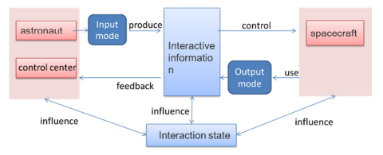
HUMAN COMPUTER INTERACTION SYSTEM
Dept. of CSE, SVIT 4

Slide 5
Human Computer Interaction System Requirements
The Requirements of human computer interaction system can be divided into 3 levels:
First Level ( Basic Functional Requirements ) : Ensuring the safety of spacecraft and the life safety of astronauts in orbit. Mainly includes monitoring & perception of spacecraft and human’s own state.
Second Level ( Task Requirements ) : Ensures the stable operation of spacecraft and support the astronauts to complete the short-term mission of deep space exploration. It includes monitoring & sensing of spacecraft external environments, docking, etc.
Third Level (Application Service Requirements ) : The functions involved in astronauts long-term stay on the planetary surface, including autonomous fault location and repair, collaborative sensing, etc.
Dept. of CSE, SVIT 5

Slide 6
Development Trend
From Graphical interface to spontaneous interaction :
The interaction between the astronauts and the spacecraft should be spontaneous and this can be done by including modules that will sense the human senses, expression and other human features and process this data to provide a 3D and continuous interaction with the astronauts.
From Single Channel and mode to Multichannel :
The system collects information from the surrounding and the spacecraft with the support of big data, internet of things and cloud computing technology. This information is then computed and then the result is passed to the astronauts and the control centre.
From man machine cooperation to man machine intelligence fuse :
The spacecraft can me made intelligent by the use of robot and machine learning modules, which will sense the astronaut and the surroundings to warn or interact with the astronaut as and when required to achieve situational awareness.
Dept. of CSE, SVIT 6

Slide 7
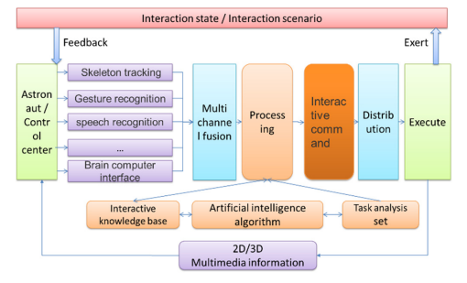
Conceptual Model
Dept. of CSE, SVIT 7

Slide 8
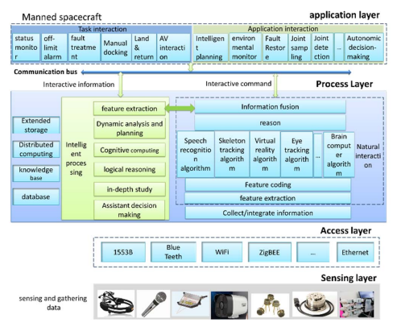
Architecture Design
Dept. of CSE, SVIT 8

Slide 9
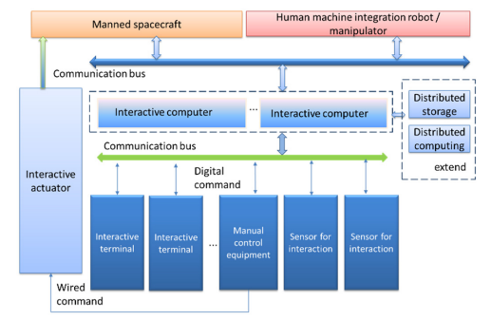
System Components
Dept. of CSE, SVIT 9

Slide 10
Advantages
The advantages are enormous taking the future space exploration missions taken into consideration :
Safety
Human Computer coordination
Assists astronauts in performing tasks
Longer and wider planetary operations
Efficiency
Dept. of CSE, SVIT 10

Slide 11
Disadvantages
The Disadvantages of this system are :
Not always reliable
There are possibilities failure
Error in sensor reading can misdirect the spacecraft and astronaut
Less margin for error
Dept. of CSE, SVIT 11

Slide 12
Application
Space Exploration
Deep Space Exploration
Manned Space Missions
Planetary Exploration
Dept. of CSE, SVIT 12

Slide 13
Conclusion
The human computer interaction system of manned spacecraft based on deep space exploration is an indispensable part of the future spacecraft.
It can ensure the safety of astronauts, assist astronauts to complete planetary surface operation tasks more efficiently and carry out planetary surface operations for a longer and wider area.
It will help in the discovery of many unknowns that are still a question mark when it comes to space and the objects beyond a certain distance in space.
Dept. of CSE, SVIT 13

Slide 14
Reference
[1] W. Li and H. Cheng, "Requirements and Architecture Design of Human Computer Interaction System for Manned Spacecraft Based on Deep Space Exploration Mission," 2021 2nd International Conference on Intelligent Computing and Human-Computer Interaction (ICHCI), 2021, pp. 204-208, doi: 10.1109/ICHCI54629.2021.00050.
[2] M. K. Lee, K. P. Tang, J. Forlizzi and S. Kiesler, "Understanding users! Perception of privacy in human-robot interaction," 2011 6th ACM/IEEE International Conference on Human-Robot Interaction (HRI), 2011, pp. 181-182.
[3] Zhou Qianxiang, Wei zhehao, Research progress of human computer interaction technology for manned spacecraft[J]. Chinese Journal of aerospace medicine, 2005, Vol.16, No.4
Dept. of CSE, SVIT 14

Slide 15


